Slide 1
Tackling Short-Termism
2019 Business and Economics Lecture Programme
Tej Parikh, Chief Economist
Bath Royal Literary and Scientific Institution
11 June 2019

Slide 2
Creative Commons// "JMP_8888 XR Melbourne" by Julian Meehan

Slide 3
Outline – Short-Termism
1.What is it? Evolutionary Origins
2.Why is it a problem? Democratic Myopia
3. Solutions: Institutions, Incentives & Culture

Slide 4
“There is no quality in human nature, which causes more fatal errors in our conduct, than that which leads us to prefer whatever is present to the distant and remote, and makes us desire objects more according to their situation than their intrinsic value.”
--David Hume, A Treatise of Human Nature

Slide 5
I) Do you prefer to be given (a) £1000 today, or (b) £1005 in 3 days
II) Do you prefer to be given (a) £1000 in 100 days, or (b) £1005 in 103 days

Slide 6
“…he lives from day to day indulging the appetite of the hour…often he is busy with politics, and starts to his feet and says and does whatever comes into his head... His life has neither law nor order; and this distracted existence he terms joy and bliss and freedom; and so he goes on.”
--Plato

Slide 7
“In politics the dominant time frame is a term of office, in fashion and culture it’s a season. For corporations it’s a quarter, on the internet it’s minutes, and on the financial markets [it is] mere milliseconds.”
--Esther Dyson

Slide 8
Causes of Democratic Myopia
1. The Electoral Cycle
2. Media
3. Party Politics
4. Interests

Slide 9
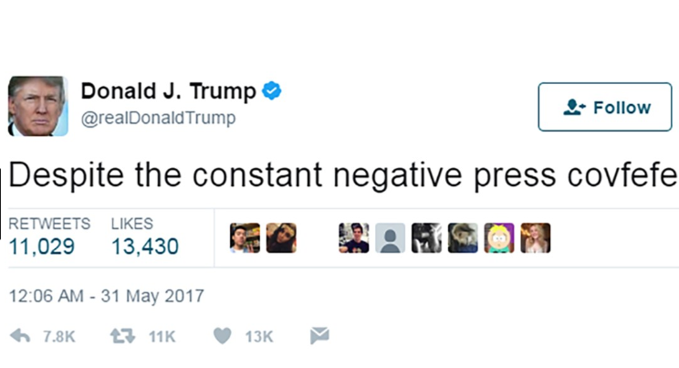

Slide 10
Causes of Democratic Myopia
1. The Electoral Cycle
2. Media
3. Party Politics
4. Interests

Slide 11
The Effects of Democratic Myopia
Short-Term Policy Making
Lack of Horizon Scanning
Vacuum in Long Term Governance
Lack of Resilience to Shocks
Loss of Trust
Instability
Uncertainty

Slide 12
Business & Economic Confidence
Source: IoD Policy Voice Survey, Net %

Slide 13
Challenges Facing the Economic Agenda
Source: IoD Policy Voice Survey, %

Slide 14
The Effects of Democratic Myopia
Short-Term Policy Making
Lack of Horizon Scanning
Vacuum in Long Term Governance
Lack of Resilience to ‘Shocks’
Loss of Trust
Instability
Uncertainty

Slide 15
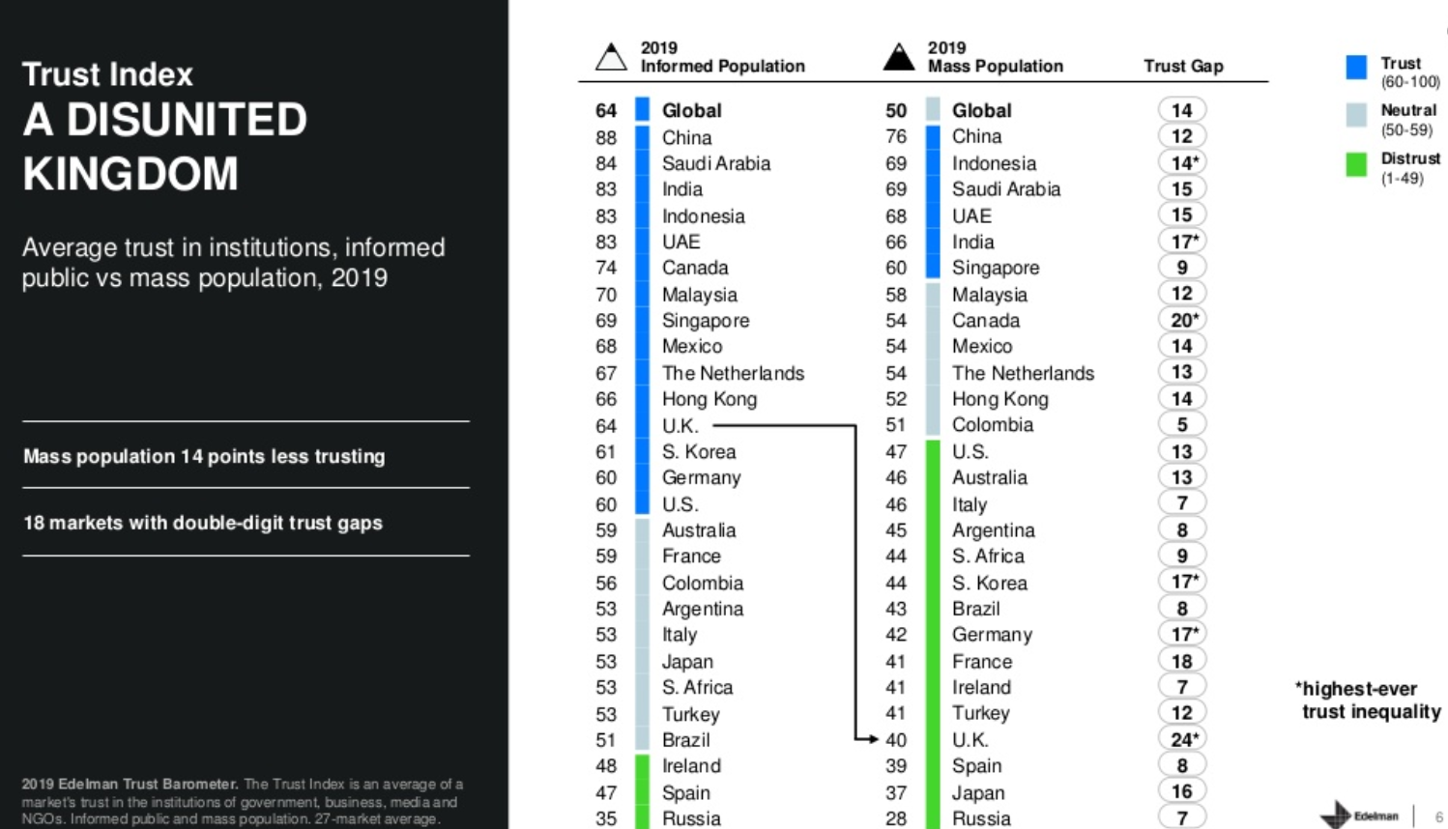
Public Trust in Gov’t, Biz, Media, NGOs
Source: Edelman Trust Barometer, January 2019, UK %

Slide 16
Democratic Conditions for Long-Termism
(Jacobs 2011)
1. Electoral Safety
2. Clear Long-Term Returns
3. Institutional Capacity

Slide 17
Institutions
1. Independent Committees
2. Improve Foresight Capacity

Slide 18
Incentives
1. Constitutional Amendments
2. Commitment Mechanisms
3. Electoral Changes

Slide 19
Culture/Behaviour
1. Education
2. Transparency, Engagement, and Rules
3. The Role of Business

Slide 20
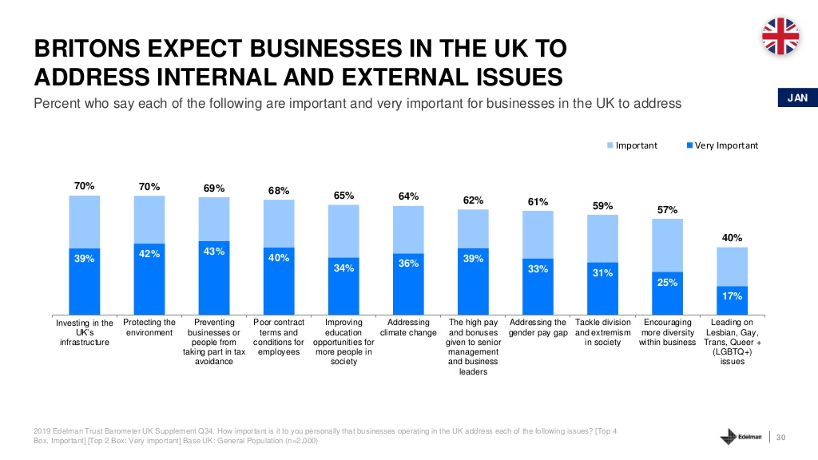
What Do We Ask of Business?
Source: Edelman Trust Barometer, January 2019, UK %

Slide 21
Tackling Short-Termism
2019 Business and Economics Lecture Programme
Tej Parikh, Chief Economist
Bath Royal Literary and Scientific Institution
11 June 2019
Notes:
Risks/Opportunity
Growth vs. Forecasts
Regional
Business Concerns
Business Prospects
Monetary Policy – Wages, Inflation (Households) -- Consumer Spending
Investment
Uncertainty
Fiscal Policy, Spring Budget
Skills
Productivity
Industrial Strategy
Global Risks – US, Brexit,
Brexit – Latest developments, what next, probabilities
Happiness
Risks
Opportunity: A Vision for the Economy
Fin.

