Slide 2
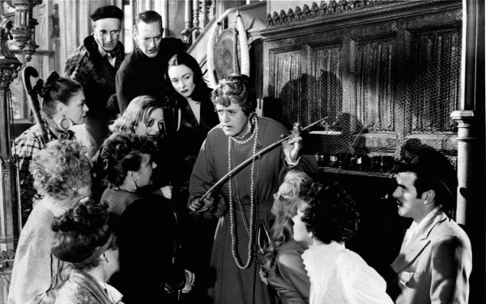
Model pupils, underachievers & troublemakers: the challenge

Slide 3
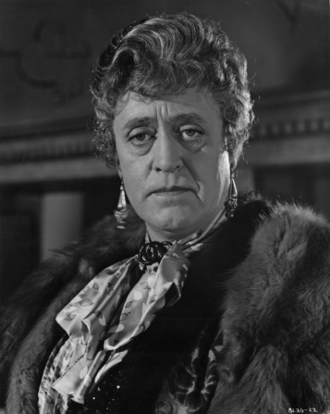
Model pupils, underachievers & troublemakers: the challenge
Economics Group Project (Sixth Form)
Explain events of 2007 / 8
Learning outcomes :
Monetary/financial production economy
Balance sheet; solvency; liquidity
Institutions
School library : mainstream, heterodox literature; data; methods
Disappointing results : just 3 of our 30 pupils passed; rest have failed

Slide 4
Model pupils, underachievers & troublemakers: model pupils
Ann, Mariana, Daniela : well done girls!
Came top of the class too in Economics Group Project (Fifth Form)
Learning outcomes achieved
A theoretical framework developed via a critical engagement with both mainstream and heterodox literature
Fastidious use of available data and use of variety of methods
Excellent scholarship

Slide 5
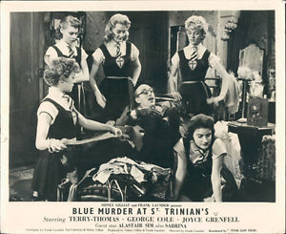
Model pupils, underachievers & troublemakers: the rest
Miss Chick at her wit's end
Most used framework taken from mainstream literature only; most citing the same few publications
Selective use of data and use of one or two methods; fabricating evidence
Dullards? Lazy? Copying?
Bullying; usual suspects
(Kennetha; Paula)
; fraternising
with some rather unsavoury
characters.

Slide 6
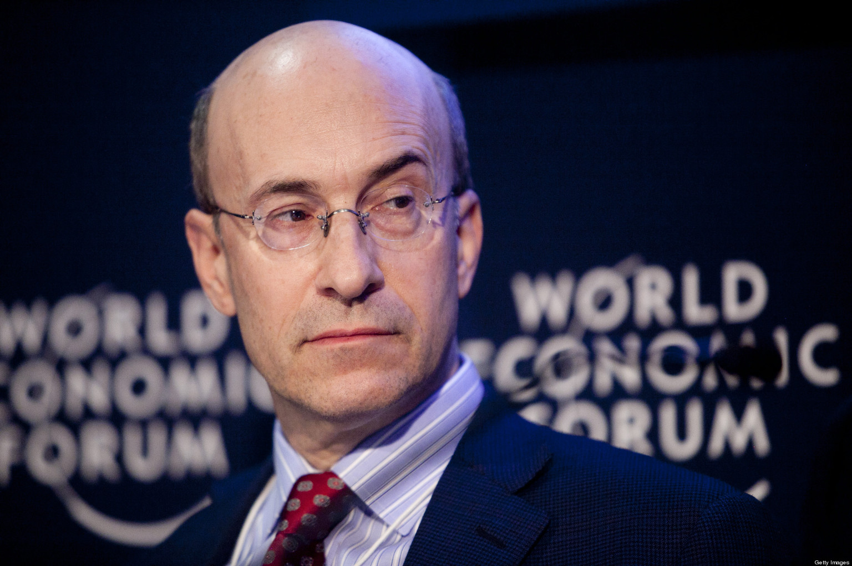
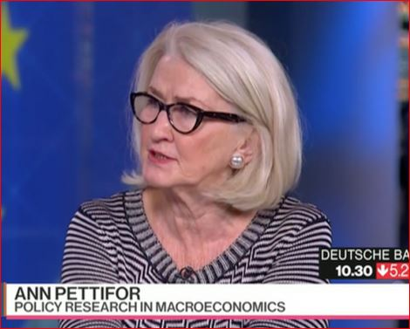
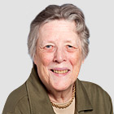
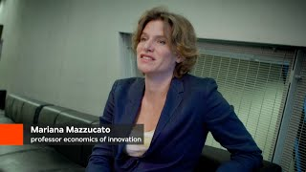
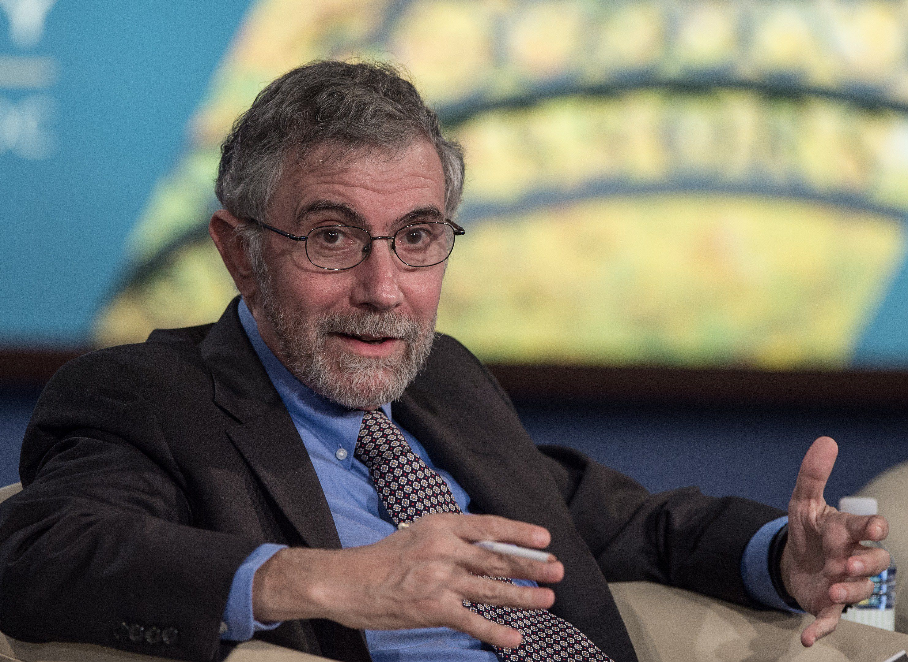
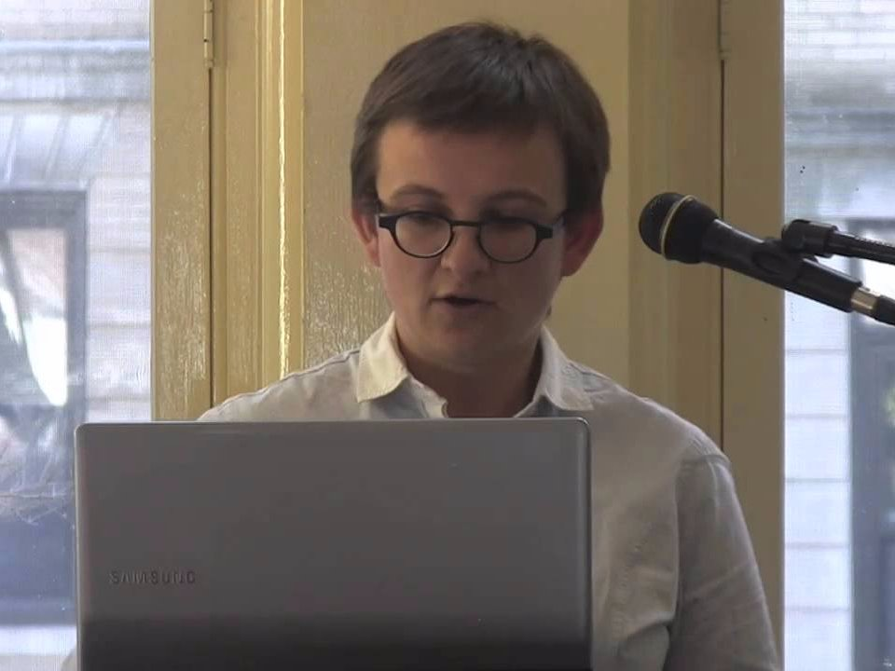
Model pupils, underachievers & troublemakers

Slide 7
Model pupils, underachievers & troublemakers
The Public
The Public
The Academy
The Academy

Slide 8
Model pupils, underachievers & troublemakers : before 2007/8
M a i n s t r e a m
O t h e r
- Rajan (2005) ?
- OECD Economic Outlook No. 80
- IMF World Economic Outlook
- Blanchard (2008) The State of Macro
- Strange (1986) Casino Capitalism
- Strange (1998) Mad Money
- Godley (1999) Seven Unsustainable Processes
- Godley & Wray (2000) Is Goldilocks Doomed?
- Pettifor (2006) The Coming First World Debt Crisis

Slide 9
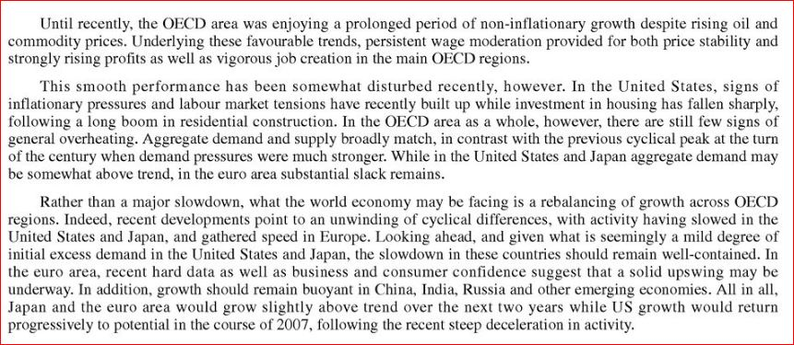
Model pupils, underachievers & troublemakers

Slide 10
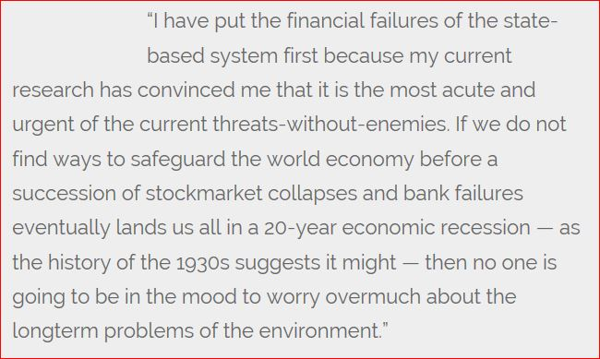
Model pupils, underachievers & troublemakers

Slide 11
Model pupils, underachievers & troublemakers : after 2007/8
M a i n s t r e a m
O t h e r
- Krugman (2009) 'How Did Economists Get It So Wrong?'
- Besley & Hennessy (2009) Letter to HM the Queen
- Quiggin (2012) Zombie Economics
- Conference BoE (2012)
- Romer (2016) 'The Trouble with Macroeconomics'
- Godley & Lavoie (2008) Monetary Economics
- Galbraith (2009) 'Who are these economists, anyway?'
- Bezemer (2009) 'No one saw this coming. Understanding financial crisis through accounting models'
- Mirowski (2014) Never Let A Serious Crisis Go To Waste
- FESSUD
- INET
- ISIPE (Etd. 2014)

Slide 12
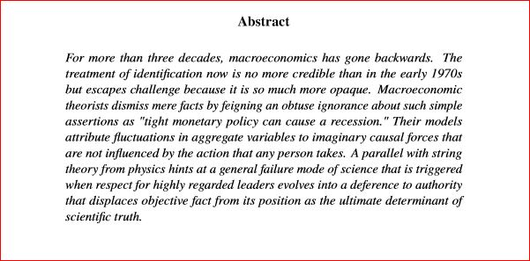
Model pupils, underachievers & troublemakers

Slide 13
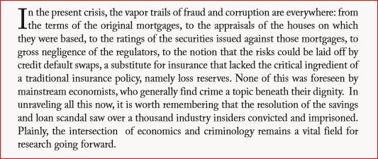
Model pupils, underachievers & troublemakers

Slide 14
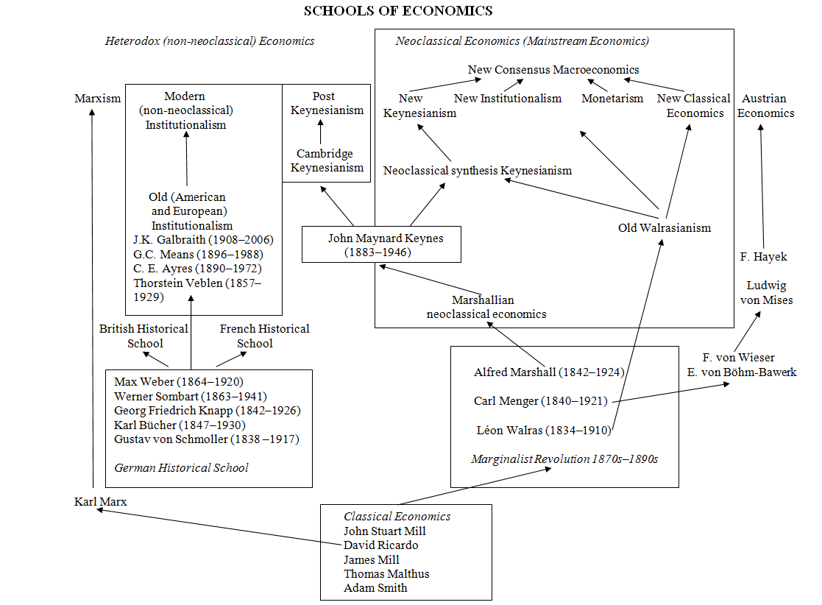
Model pupils, underachievers & troublemakers

Slide 15
Model pupils, underachievers & troublemakers
Critical Finance
PK SFC

Slide 16
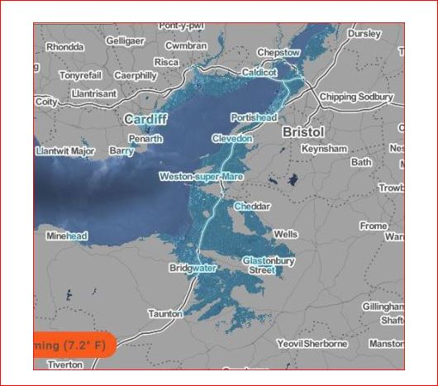
Model pupils, underachievers & troublemakers

Slide 17
Model pupils, underachievers & troublemakers
Rethinking Economics

Slide 18
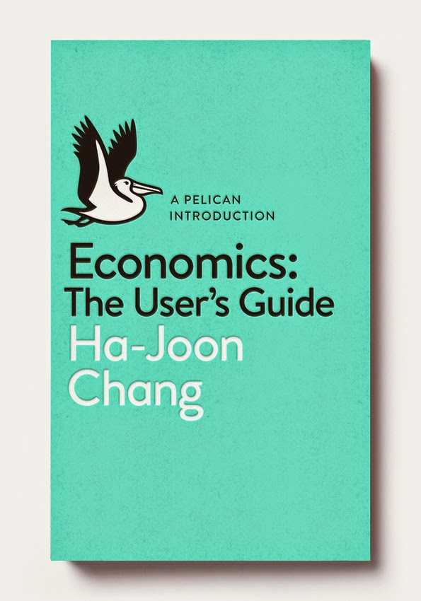
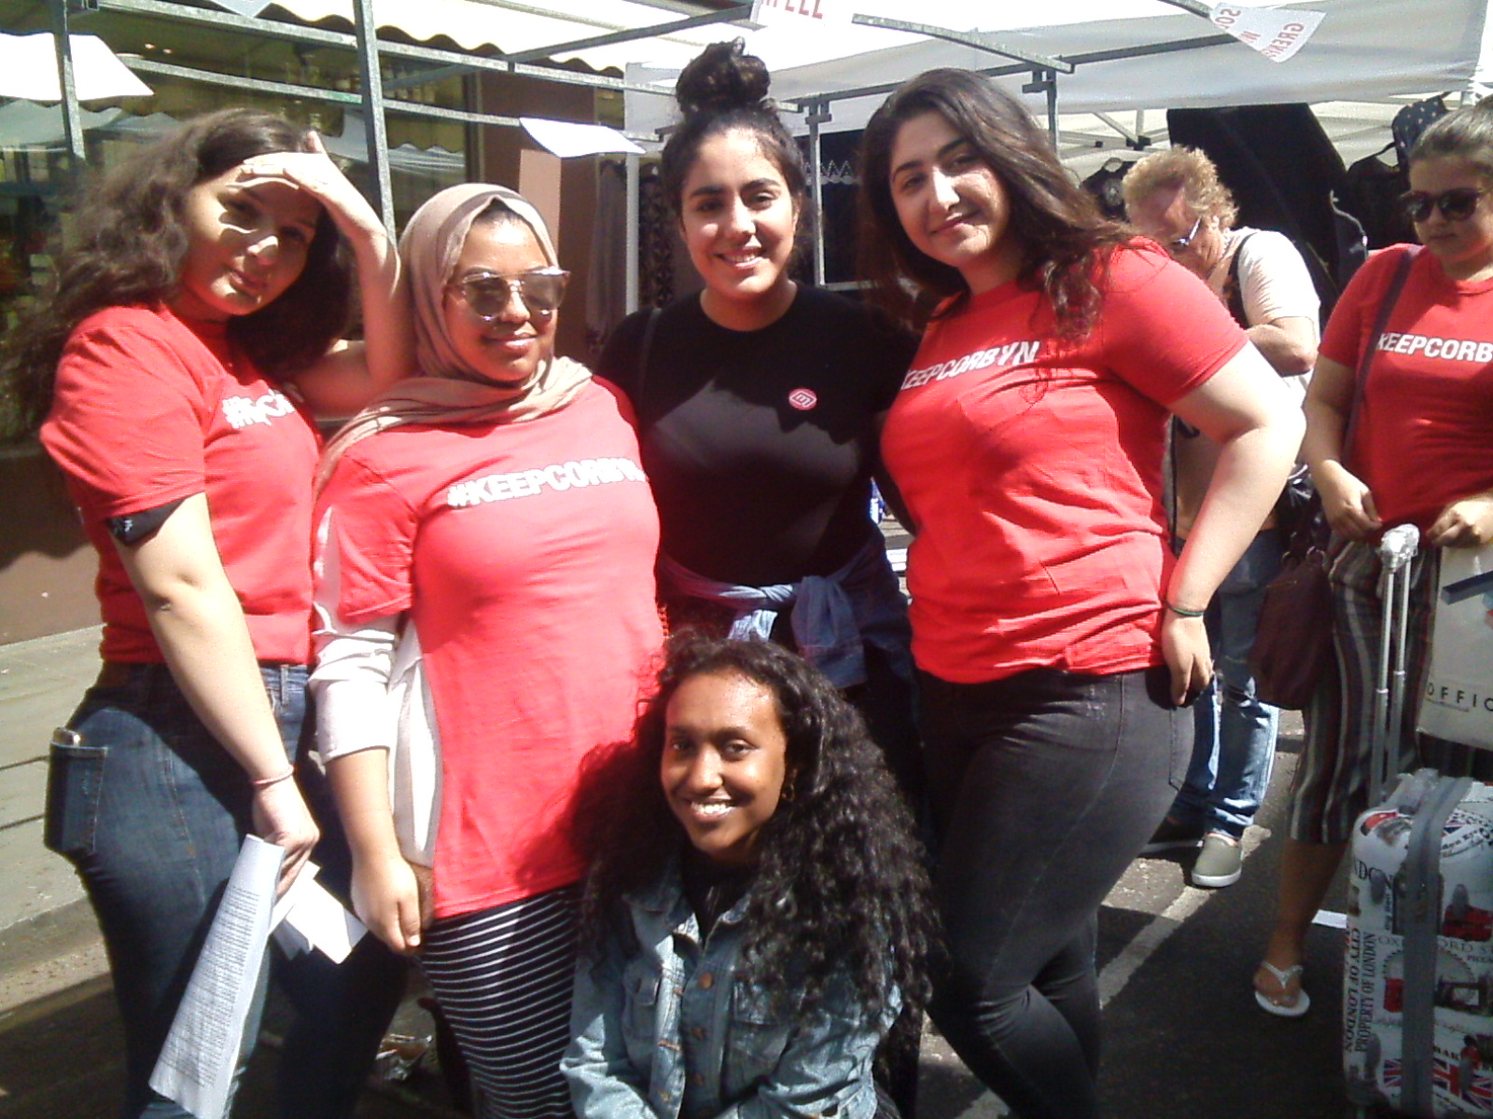
Model pupils, underachievers & troublemakers

Slide 19
Model pupils, underachievers & troublemakers
Questions / Discussion

