Slide 1
Japan’s view of the world
Koji Tsuruoka
Ambassador Extraordinary and Plenipotentiary Embassy of Japan in the United Kingdom

Slide 2
Human Security

Slide 3
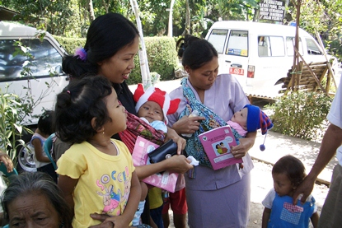
Maternal and child health handbook project (Indonesia)
Duration: 1998 -2003
48% of mothers used the handbook in 2003.
Today it is used by more than 80% of mothers.
HANDS

Slide 4
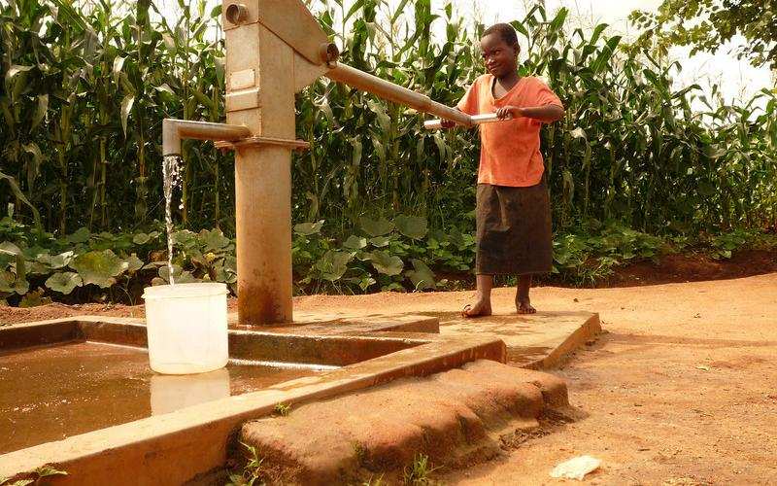
Support Youth and Women in Northern Mali
Duration: 2015 - 2018
Budget: £3,409,000

Slide 5
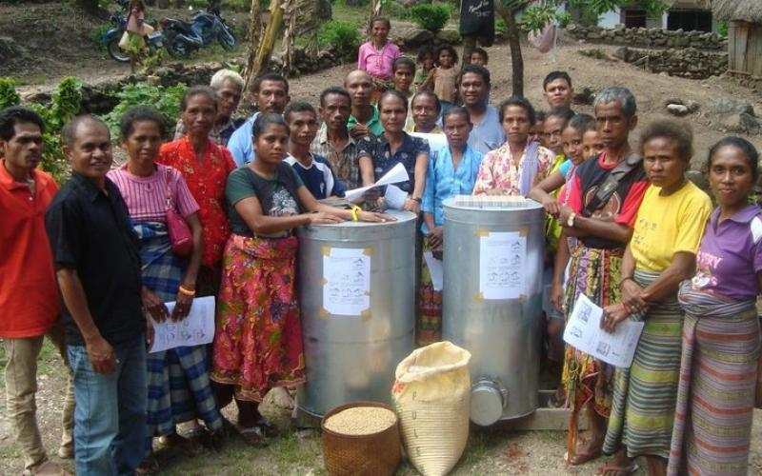
Timor Leste – Direct Support to Communities
Duration: March 2010 - August 2013
Budget: £2,802,000

Slide 6
ODA yen loans

Slide 7
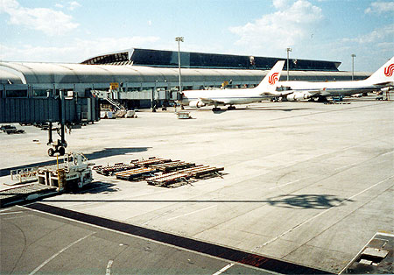
Beijing Capital Airport Terminal Area Expansion Project (China)
JICA
Loan Amount : £198million
Loan Agreement: August 1993 - December 1996
Interest rate: 2.3% - 2.6% p.a.
Repayment period: 30 years (Grace period 10 years)

Slide 8
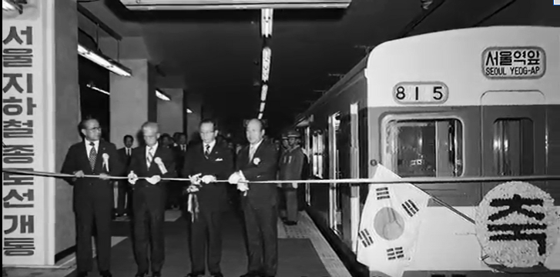
Seoul Underground Railway Project (Republic of Korea)
JICA
Loan Amount : £178million
Loan Agreement: 1971-85
Interest rate: 4.13% Repayment period: 20 years (Grace period 5 years)

Slide 9
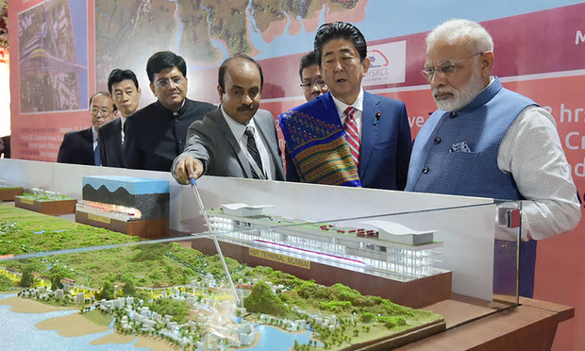
Mumbai Ahmedabad High Speed Railway (India)
Loan amount: £670million
Interest rate : 0.1% Repayment period: 50 years(Grace period 15 years)

Slide 10
Top 15 Recipients of Japan’s Yen Loans 1966-2015
(Based on E/N, Unit: GBP£ billion)
 | Recipient | Total
1 | India | 32.9
2 | Indonesia | 32.4
3 | China | 22.1
4 | Philippines | 18.1
5 | Viet Nam | 17.1
6 | Thailand | 14.9
7 | Bangladesh | 8.0
8 | Sri Lanka | 6.9
9 | Pakistan | 6.5
10 | Malaysia | 6.5
11 | Myanmar | 5.8
12 | Turkey | 4.6
13 | Egypt | 4.5
14 | Iraq | 4.4
15 | Republic of Korea | 4.3
15 Recipients total |  | 189

Slide 11
Security environment

Slide 12
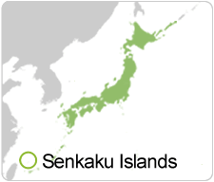
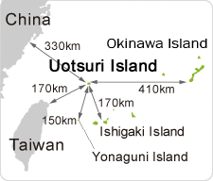
East China Sea :Senkaku Islands
8
Notes:
Updated 14 Sep

Slide 13
Records of Intrusions of Chinese Government and Other Vessels into Japan's Territorial Sea
GOJ’s acquisition of ownership of Senkaku islands (Sep. 2012)

Slide 14
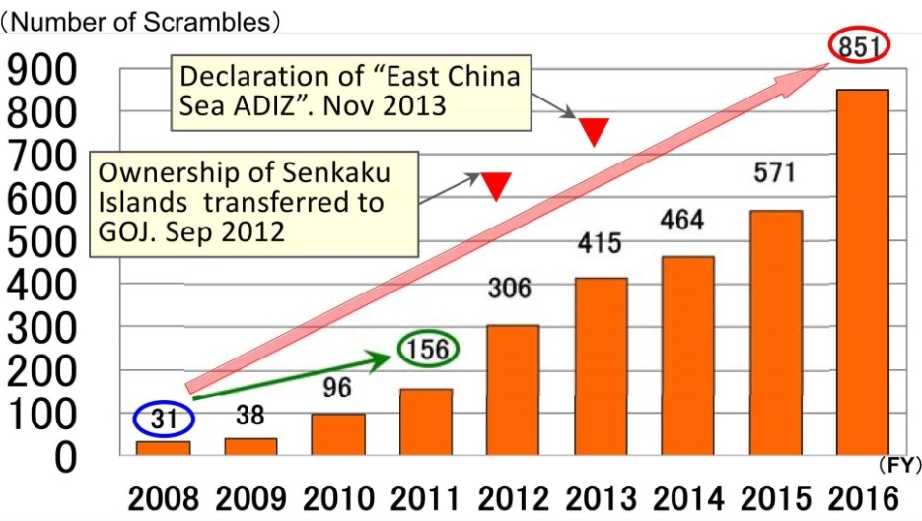
Rapid Increase in the number of scramble takeoffs by JASDF against Chinese aircraft

Slide 15
KEDO
（The Korean Peninsula Energy Development Organization)
Established on March 1995 to implement the 1994 Agreed Framework between the US and North Korea
Members: Japan, US, ROK, the EU, NZ, Australia, Canada, Indonesia, Chile, Argentina, Poland, Czech Republic, Uzbekistan
North Korea abandons nuclear weapon program.
Members (1) to finance and construct two light-water reactors
(2) to provide 500,000 tons of heavy fuel a year
2002 KEDO suspended its operation

Slide 16
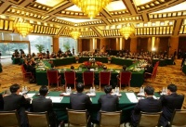
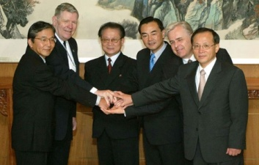
Six Party Talks
China, Japan, North Korea, Russia, South Korea and the US negotiated to dismantle North Korea’s nuclear programme.
Round 1 August 2003
Agreed not to take unilateral actions to change the status quo
Round 2 March 2004
Round 3 June 2004
Round 4 August 2005 Joint Statement
North Korea to abandon all nuclear weapons and existing nuclear programme and return to the NPT and IAEA safeguards
Round 5 February 2007
Agreement for steps to be taken to implement the joint statement
Round 6 Sepember 2007

Slide 17
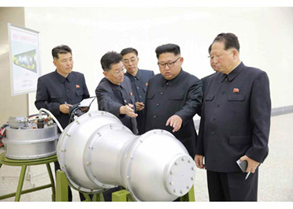
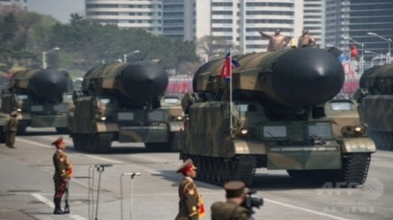
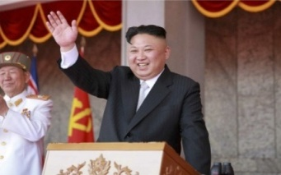
Kim Jong-Un Regime(6 years)
North Korea: nuclear and missile programme
Kim Il-Sung Regime
Kim Jong-Il Regime
(17 years)
2012-2015
2016
2017
2012.4.13: “satellite launch”
2012.12.12: “satellite launch”
2013.2.12: nuclear test
2014.3.3: two BMs
2014.3.26: two BMs
2014.6.29: multiple BMs
2014.7.9: multiple BMs
2014.7.13: two BMs
2014.7.26: one BM
2015.3.2: two BMs
2016.1.6: nuclear test
2016.2.7: “satellite launch”
2016.3.10: two BMs
2016.3.18: one BM
2016.4.15: one BM
2016.4.23: one SLBM
2016.4.28: two BMs
2016.5.31: one BM
2016.6.22: two BMs
2016.7.9: one SLBM
2016.7.19: three BMs
2016.8.3: two BMs
2016.8.24: one SLBM
2016.9.5: three BMs
2016.9.9: nuclear test
2016.10.15: one BM
2016.10.20: one BM
2017.2.12: one BM
2017.3.6: four BMs
2017.3.22: one BM
2017.4.5: one BM
2017.4.16: one BM
2017.4.29: one BM
2017.5.14: one BM
2017.5.21: one BM
2017.5.29: one BM
2017.7.4: one ICBM
2017.7.28: one ICBM
2017.8.29: one BM
2017.9.3: nuclear test
2017.9.15: one BM
1993.5.29: one BM
1998.8.31: “satellite launch”
2006.7.5: multiple BMs
2006.10.9: nuclear test
2009.4.5: “satellite launch”
2009.5 25: nuclear test
2009.7.4: multiple BMs
2018
No nuclear tests

Slide 18
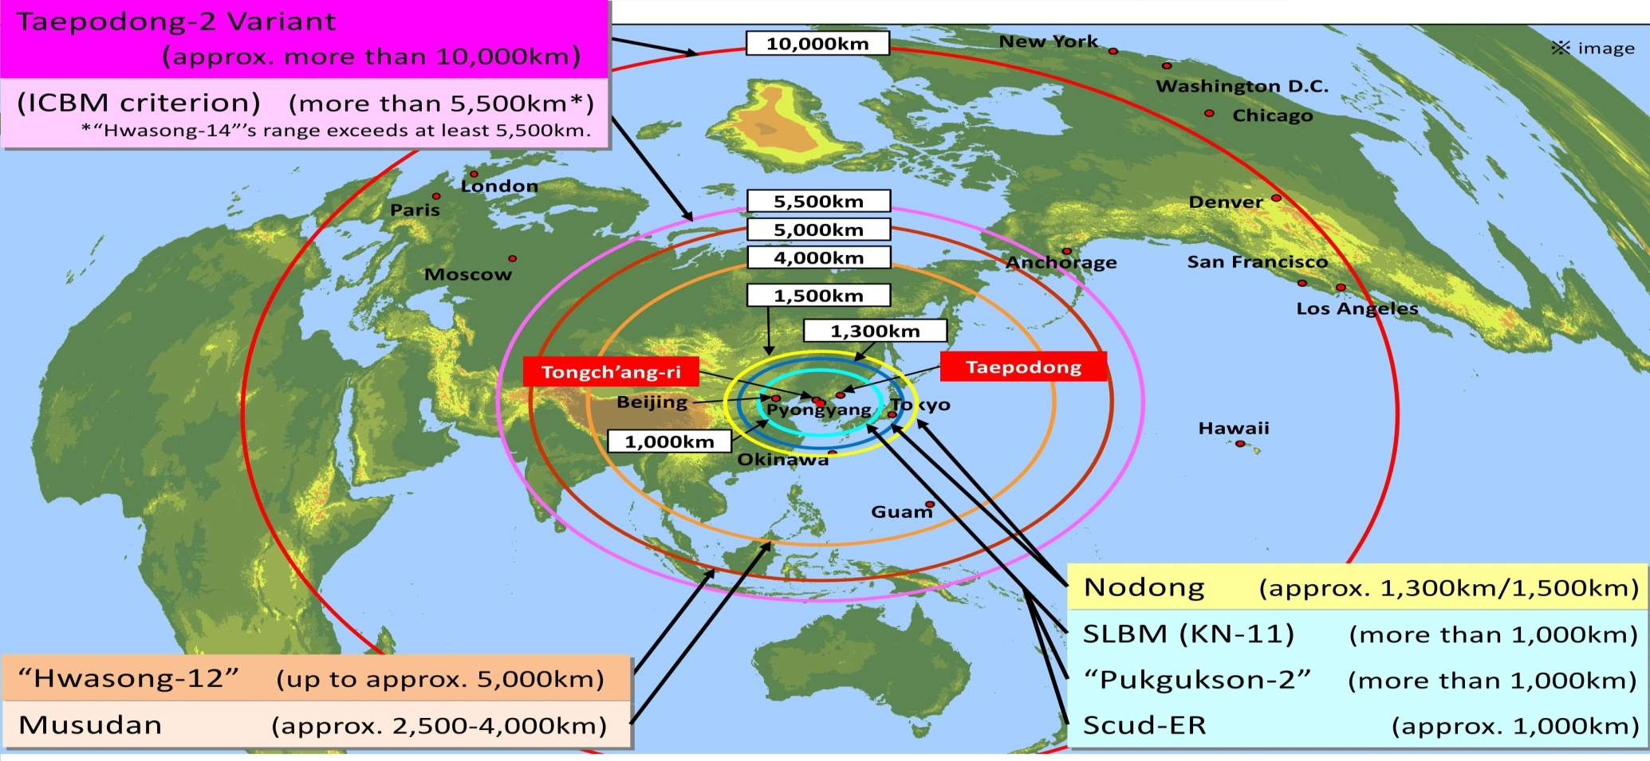
Range of North Korean Ballistic Missiles
Source: Japan’s Defense White Paper 2016
This shows a rough image of the distance each missile can reach from Pyongyang for the sake of convenience.

Slide 19
Japan: Partner of the British Economy

Slide 20
Japanese investment in the UK
Investment in the UK from Japan reached a record high in 2017 at 78 billion GBP. No. 2 Non-EU Companies
With HQ in London

Slide 21
1,000
Companies
2017-2018
3,000
New Jobs
150,000
Jobs

Slide 22
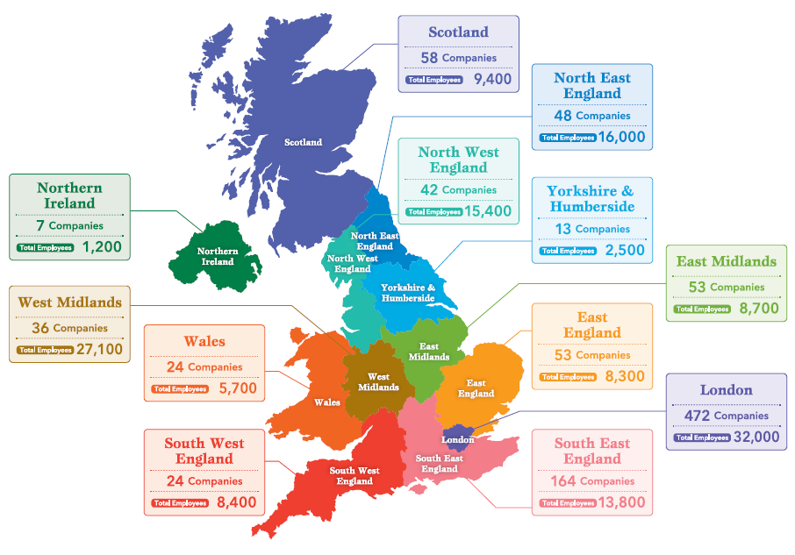

Slide 23
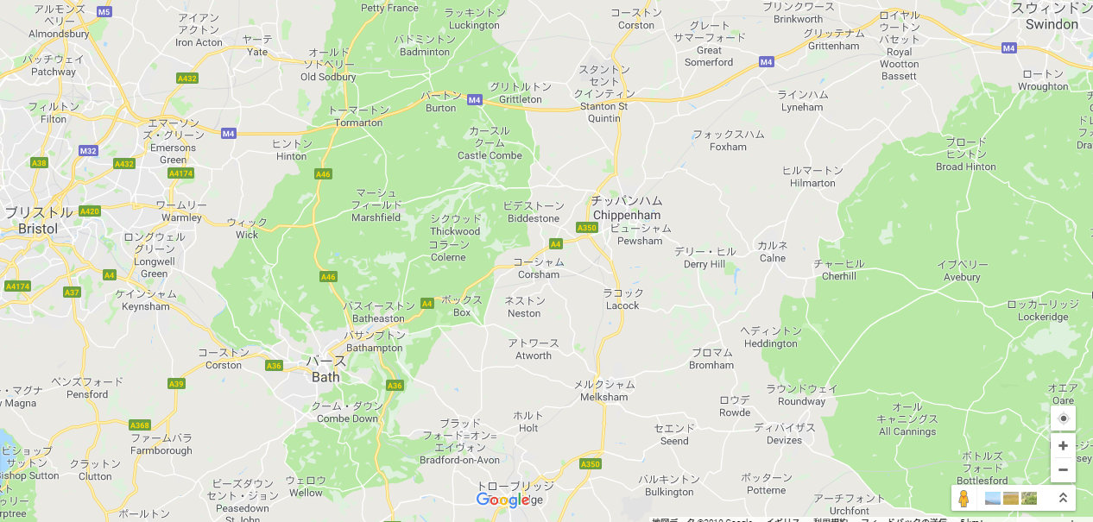
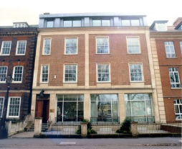
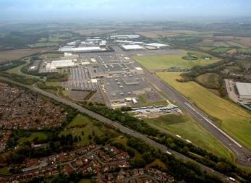
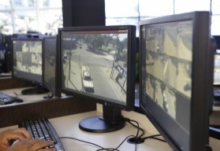
Japanese companies around Bath
Toshiba Research Europe Limited, Telecommunication Research Laboratory
30 employees (includes 17 Doctoral researcher)
Swindon
Sanoh UK Manufacturing
340 employees
Honda
3000 employees
Produce 164,000 cars/year
Sales (UK :12%, export:88%(EU:76%))
Bristol
Cookpad
20 employees
Japanese companies in Swindon area:
10 including Honda group companies, Ohashi Technica, Pentel, Johnan etc
Bath
NEC collaborate with the “Bristol Is Open”
Contribute to the digital transformation of city operations in the UK.

